Slide 1
BRAIN TUMOR DETECTION
PRESENTED BY
Aditya Rajesh Jadhav
2020BIT044
9370144795
GUIDED BY
Dr. Ganesh Pakle Sir

Slide 2
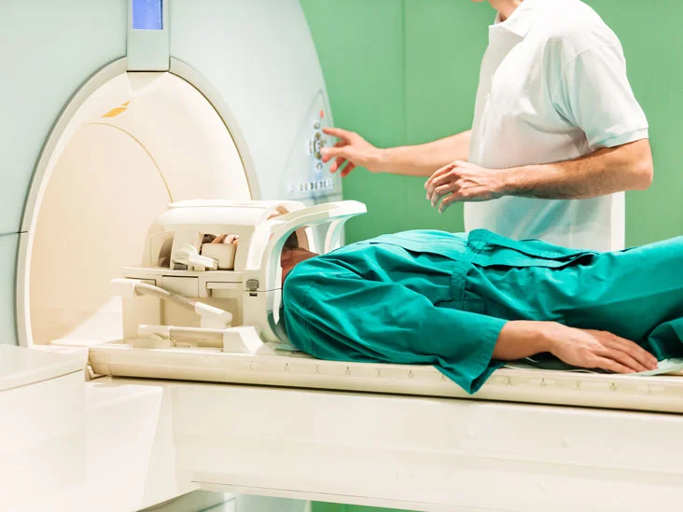
AGENDA
INTRODUCTION
MOTIVATION
LITERATURE SURVEY
REMARKS
DATASET
METHODS
RESULT
CODING
FUTURE SCOPE
CONCLUSION

Slide 3
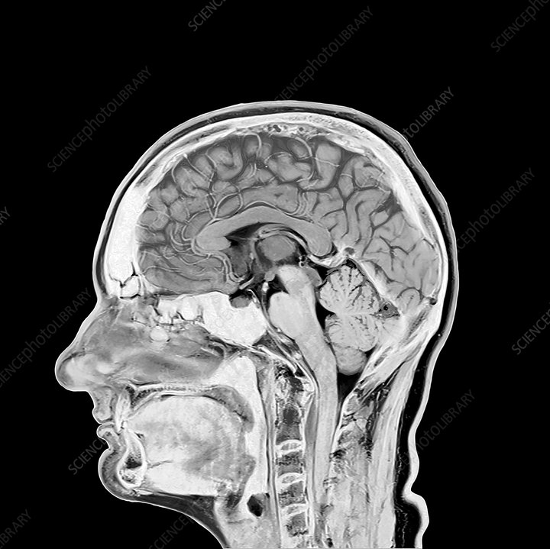
Introduction
A brain tumor refers to an abnormal growth of cells within the brain. These tumors can develop in various areas of the brain and can be either benign (non-cancerous) or malignant (cancerous). Brain tumors are a serious health concern as they can interfere with the normal functioning of the brain and nervous system.
Types of brain tumor :
1.Gliomas tumor (malignant)
2.Meningiomas tumor (benign)
3.Pituitary tumor (benign )

Slide 4

Motivation
Brain tumors have a profound global impact, with approximately 700,000 annual diagnoses worldwide. An automated brain tumor detection system using CT scans and MRI holds immense potential.
By harnessing advanced machine learning algorithms, we can enhance accuracy, efficiency, and early detection. Prompt interventions improve patient outcomes and save lives.
This system streamlines workflows, optimizing healthcare resources and reducing the radiologist’s burden. Moreover, it enhances treatment planning, enabling targeted approaches for surgery or radiation therapy.
Particularly in underserved areas, it improves accessibility to quality healthcare services.
Our project aims to contribute to the medical field by facilitating accurate diagnoses, efficient workflows, and better patient outcomes.

Slide 5
LITERATURE SURVEY
Parameters | Brain Tumor Detection Using Convolutional Neural Network By: Tonmoy Hossain1, Fairuz Shadmani, Mohsena. | Brain Tumour Detection Using Deep Learning By: Avigyan Sinha, Malavika Suresh, Nitha Mohan R, Abinaya D, Ashwin G Singerji. | Detection of Brain Tumors Using Image Processing By: Suresha D , Jagadisha N, Shrisha H S,Kaushik K S.
Methodology | Uses K-Means clustering and SVM for brain tumor detection in MR images. | Utilizes Fuzzy C-Means clustering, traditional classifiers (SVM, KNN, MLP, etc.), and CNN for brain tumor extraction from MRI. | Applies Fuzzy C-Means clustering, traditional classifiers (SVM, KNN, MLP, etc.), and CNN for brain tumor segmentation.
Dataset | Dataset with diverse tumor sizes, locations, shapes, and image intensities. | Real-time dataset with diverse tumor sizes, locations, shapes, and image intensities. | Dataset details not specified.
Objective | Aim to detect brain tumors and improve treatment. | Focus on extracting brain tumors based on texture-based and statistical-based features. | Objective is to identify abnormal images, segment tumor regions, and estimate density for therapy.
Performance: | Accuracy is 97.87 percentage. | Accuracy is 97.67 percentage. | Accuracy is 96.96 percentage.

Slide 6
Remarks
In this project, we address the pressing challenge of brain tumor detection by developing an automated system using CT scans and MRI. With approximately 700,000 annual diagnoses worldwide, brain tumors have a significant impact on global health.
By harnessing the power of advanced machine learning algorithms, our system aims to enhance the accuracy and efficiency of brain tumor detection.
This will enable early and timely interventions, ultimately improving patient outcomes. The integration of CT scans and MRI provides complementary information, allowing for a comprehensive evaluation of tumors.
Our project contributes to the field of medical imaging by providing a reliable and accessible tool that can assist healthcare professionals in making accurate and informed decisions for brain tumor diagnosis and treatment.

Slide 7
DATASET
Dataset: Brain tumor images
Tumor Types: Glioma tumor, Meningioma tumor, Pituitary tumor, No tumor
Structure: Divided into "Training" and "Testing" folders
Training Folder: Subfolders for each tumor type
Testing Folder: Subfolders for each tumor type
Purpose: Train a CNN model for accurate tumor classification
Importance: Enables effective detection and classification of brain tumors

Slide 8
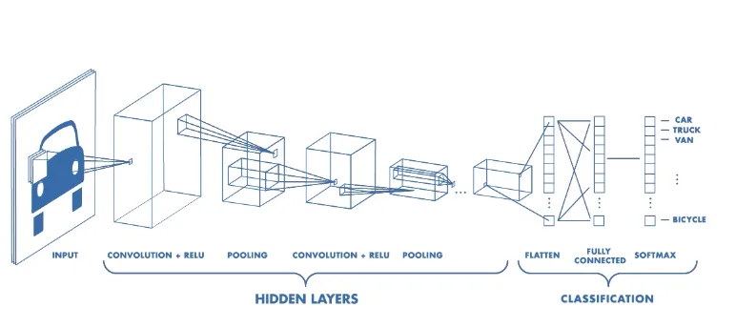
METHODS
(CNN)
Convolutional Neural Networks (CNNs) are deep learning models specifically designed for image processing and computer vision tasks. CNNs excel at image analysis by automatically learning and extracting key features, enabling tasks such as object recognition, classification, and segmentation.

Slide 9
functions and layers used
Activation Functions:
ReLU: `activation='relu'`
Sigmoid: `activation='sigmoid'`
Layers:
Conv2D: `Conv2D(filters, kernel_size, activation='relu', input_shape=input_shape)`
MaxPooling2D: `MaxPooling2D(pool_size=(2, 2))`
Flatten: `Flatten()`
Dense: `Dense(units, activation='relu')`

Slide 10


coding

Slide 11
CONCLUSION
this project successfully developed and trained a Convolutional Neural Network (CNN) model for the detection and classification of brain tumors.
The model achieved promising results in accurately identifying four different tumor types: glioma tumor, meningioma tumor, pituitary tumor, and no tumor.
the developed CNN model showcased the power of image processing and deep learning techniques in the field of medical diagnostics.
Continued research and development in this area hold immense promise for the future of brain tumor diagnosis and treatment.

Slide 12
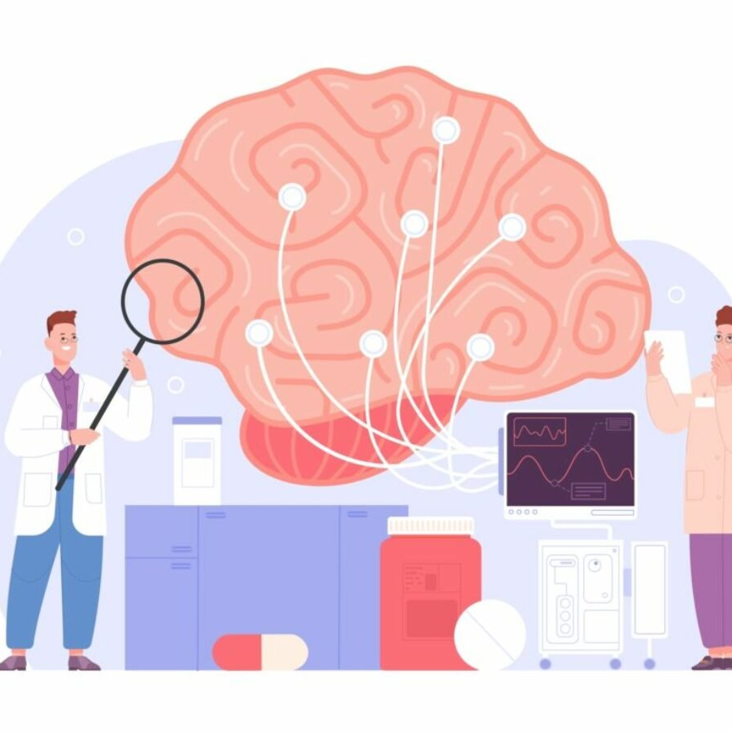
FUTURE
SCOPE
Quantitative Imaging Biomarkers:
Researchers are focusing on developing quantitative imaging biomarkers derived from MRI images. These biomarkers can provide objective and quantitative measurements of tumor characteristics, such as size, shape, perfusion, and diffusion. By analyzing these biomarkers, it may be possible to enhance tumor characterization, predict tumor aggressiveness, and monitor treatment response more accurately.
Advanced Image Processing Techniques:
Advanced Image Processing Techniques: Ongoing research aims to develop advanced image processing algorithms to improve image quality, reduce noise, enhance tumor visibility, and enable real-time image analysis. These techniques may include image registration, segmentation, and fusion methods, as well as novel visualization techniques for better understanding and interpretation of MRI brain images.

Slide 13

References
Research papers
https://www.researchgate.net/publication/337768246_Brain_Tumor_Detection_Using_Convolutional_Neural_Network
https://www.researchgate.net/publication/372778182_Brain_Tumor_Detection_using_Deep_Learning
https://www.researchgate.net/publication/365982354_Brain_Tumor_Detection_Using_Image_Processing_Approach
Dataset
https://www.kaggle.com/datasets/masoudnickparvar/brain-tumor-mri-dataset
Video references
https://www.youtube.com/watch?v=sR-2KXuaQRw
https://www.youtube.com/watch?v=Gc6MSamMtRo
https://www.youtube.com/watch?v=x5b_q-RjvwM
https://www.youtube.com/watch?v=E5Z7FQp7AQQ&list=PLuhqtP7jdD8CD6rOWy20INGM44kULvrHu

Slide 14
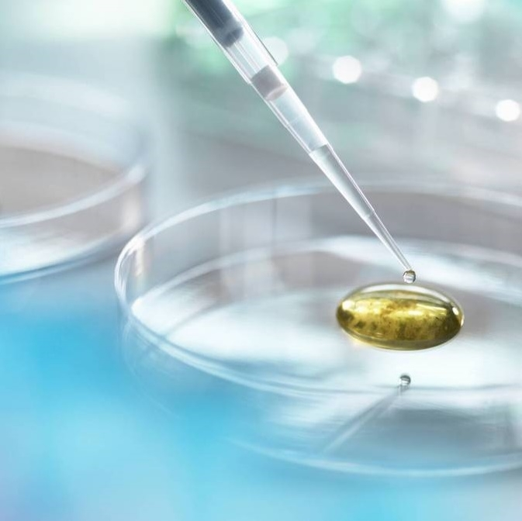
Thank you

